Slide 1
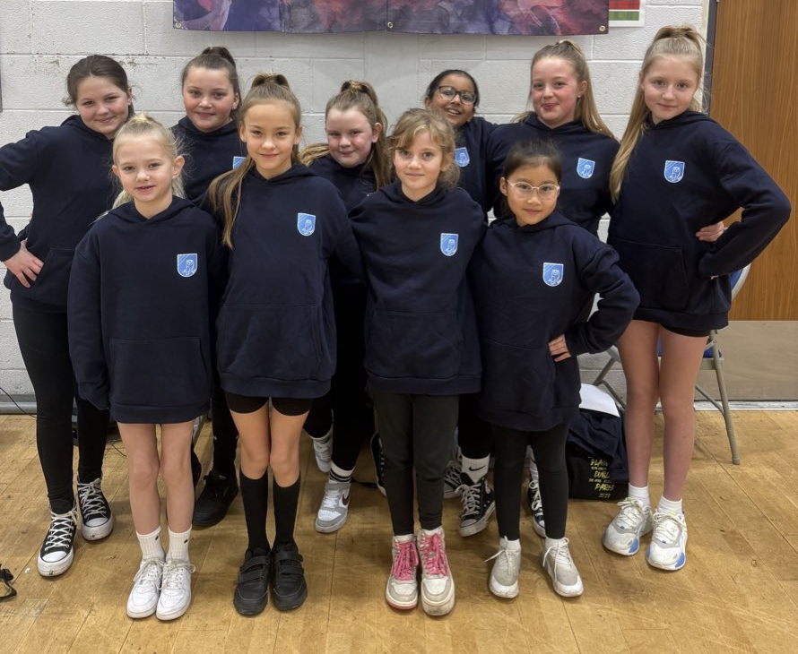
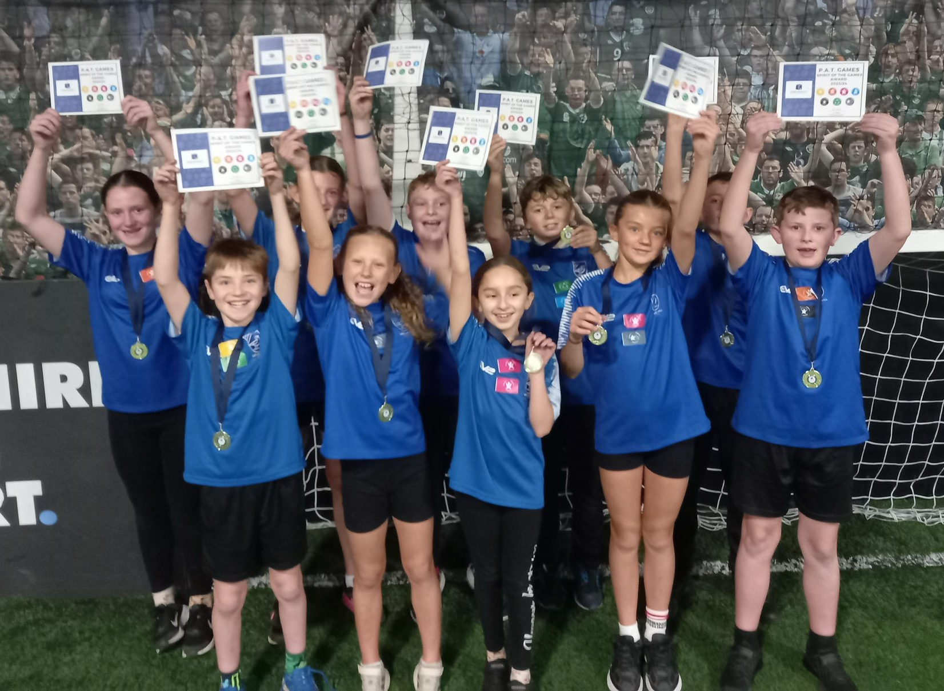

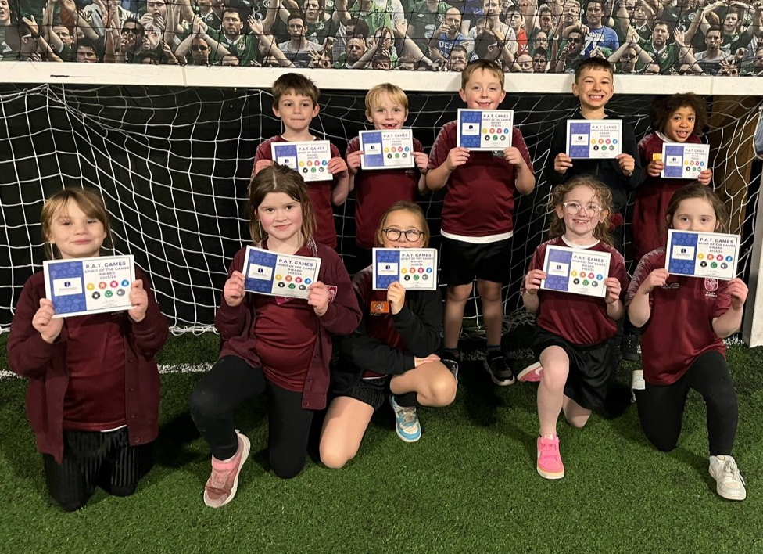





Pontefract Academies Trust
PAT GAMES CHAMPIONSHIP
AUTUMN 2 UPDATE
HIGHEST ATTENDANCE
80 POINTS
MOST SPIRIT OF THE GAMES STICKERS
67 POINTS
 | ATTENDANCE | SPIRIT OF THE GAMES | PERFORMANCE | TOTAL
CARLETON PARK | 70 | 46 | 12 | 128
DE LACY | 80 | 67 | 9 | 156
HALFPENNY LANE | 75 | 50 | 12 | 137
LARKS HILL | 60 | 57 | 14 | 131
NORTHFIELD | 70 | 67 | 14 | 151
ORCHARD HEAD | 55 | 53 | 15 | 123
THE ROOKERIES | 60 | 47 | 7 | 114
MOST POINTS FROM PERFORMANCE
15 POINTS

